Slide 1

SECURE AI OPERATIONS PLATFORM
Flowchestra operationalizes AI.
Operational infrastructure for governed AI execution.
Raum Sandoval | CEO & Co-Founder
ConvergeSouth 2026
Notes:
Open calm. Flowchestra is a Secure AI Operations platform. One line: Flowchestra operationalizes AI.

Slide 2
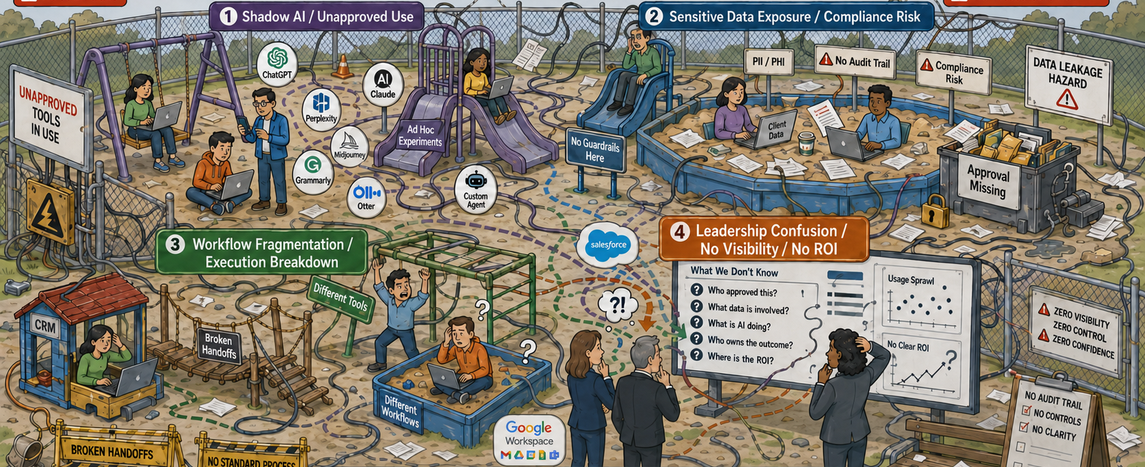
THE PROBLEM
AI Chaos Is Already Inside the Business
AI adoption is outpacing business context, governance, execution structure, and measurement.
01
Shadow AI / Unapproved Use
02
Sensitive Data Exposure / Compliance Risk
03
Workflow Fragmentation / Execution Breakdown
04
Leadership Confusion / No Visibility / No ROI
Businesses don't have an AI access problem.
They have an AI operational risk problem.
Notes:
AI is already inside the business, unmanaged. Four failure modes. The payoff line: this is an operational risk problem, not an access problem.

Slide 3
TECHNOLOGY RESPONSE
The Market Responded With More Fragmentation
Every tool solves a piece of the problem. None gives the business a complete operating model.
AI Security
Agent Builders
Protect the AI
Governance
Build the AI
Control the AI
Copilots
Observability
Use the AI
Automation / Orchestration
Watch the AI
Connect the AI
But who makes all of it work together inside the business?
The business is still left assembling the operating model.
Notes:
Six capable categories, each solving one piece. The connections between them never resolve — the business is left assembling the operating model.

Slide 4
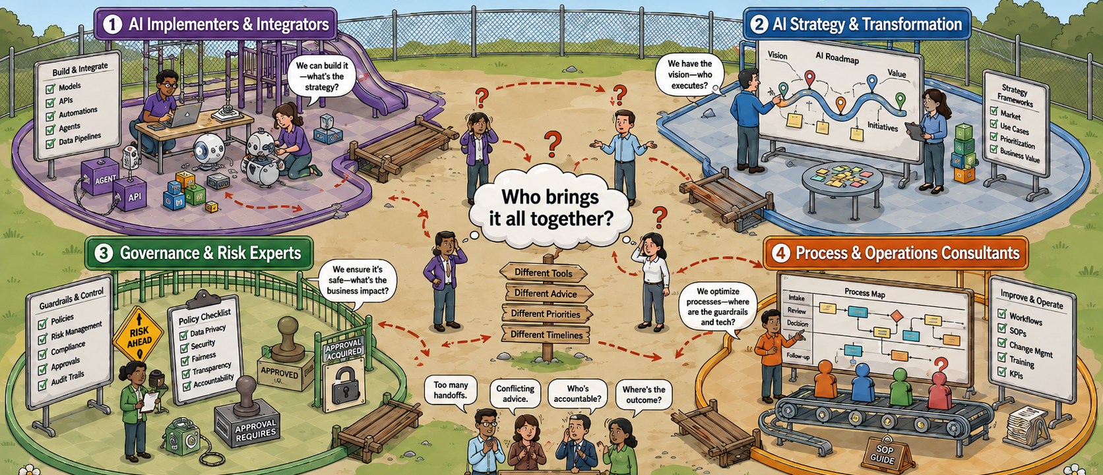
SERVICES RESPONSE
The Services Response Is Fragmented
Everyone has a piece of the answer. No one owns the full operating model.
AI Implementers & Systems
Integrators
How do we build and connect it?
AI Strategy & Transformation
Where should we use AI, and what should change?
Governance, Risk & Compliance
How do we control and trust it?
Business Process & Operations
How does the business actually work?
Different tools.
Different expertise.
Different operating models.
The market has the expertise.
What it lacks is a repeatable way to bring it together around the business.
Notes:
The expertise exists and it is good. What is missing is a repeatable way to bring it together around the business. These firms are customers and partners.

Slide 5
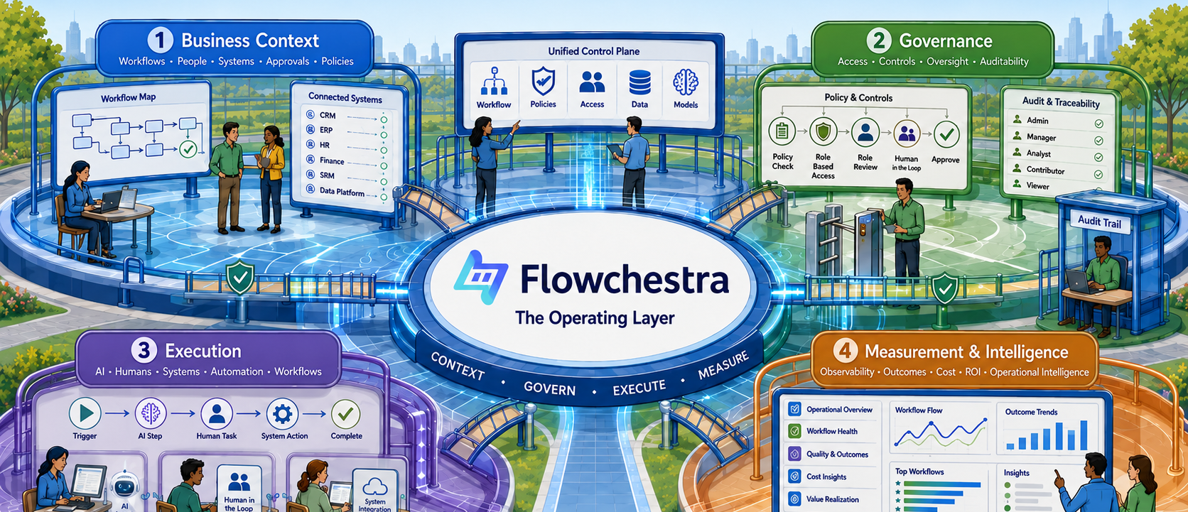
THE PLATFORM
Flowchestra Brings It Together
Operational infrastructure for governed AI execution.
Business Context
Workflows · People · Systems · Approvals · Policies
Governance
Access · Controls · Oversight · Auditability
Execution
AI · Humans · Tools · Automation · Workflows
Measurement & Intelligence
Observability · Outcomes · Cost · ROI · Operational intelligence
Flowchestra turns fragmented expertise into repeatable AI operations.
Notes:
Resolution of slide 2. Business context, governance, execution, measurement — one platform layer. Flowchestra turns fragmented expertise into repeatable AI operations.

Slide 6
WHY NOW
Trust Requires Accountability
AI demand is accelerating faster than businesses can establish ownership, governance, and operating discipline.
AI demand now touches every part of the business
What the business needs
Leadership
Ownership Within the Business
Operations
Leadership · Operations · IT / Security · Governance
Who owns the outcome?
IT / Security
Compliance / Risk
AND/OR
Functional Teams
AI / Innovation
AI Service Provider
An outsourced path to accountable AI execution
The demand is clear. We’re the solution.
Flowchestra meets businesses where they are, supporting internal ownership, AI Service Providers, or both, with governed execution, clear accountability, and visible outcomes.
Notes:
AI responsibility is spread across the business, so no one owns the outcome. Accountability can sit inside the business, with an AI Service Provider, or both. Flowchestra is the infrastructure that makes either model governed, visible, and measurable.

Slide 7

GO-TO-MARKET
Two Paths to Market. One Platform.
PATH 1 — DIRECT
PATH 2 — PROVIDER-LED
↓
↓
AI Service Provider
Business
↓
Business
Business
Business
Regulated and operationally complex organizations adopt Flowchestra directly.
One provider relationship can unlock many deployments across a client portfolio.
Same platform.
Same business outcome.
~$17B
~$2.7B
~22%
48%
Core governed AI operations TAM
Initial serviceable market
Annual AI orchestration market growth
of MSPs rank AI as their #1 client need
Notes:
Two motions, one platform. Direct into regulated businesses; provider-led through MSPs and AI consultancies for leverage. Market size and timing are supporting proof, not the headline.

Slide 8
TRACTION
Early Traction Is Validating the Model
Revenue, market engagement, and efficient targeted outbound are validating both the problem and our path to market.
ADOPTION
MARKET ENGAGEMENT
OUTBOUND EFFICIENCY
FUNNEL QUALITY
90%
Paying Customers + Design Partners
26+
18.8% / 25%
Of ICP prospects advance after first meeting Demo · second meeting · scoping · commercial discussion
Organizations engaged across both GTM motions
LinkedIn booking rate / targeted cold outreach conversion
Live real-world Beta adoption
PROBLEM VALIDATION
ENTERPRISE GATES
INDUSTRY VALIDATION
ECOSYSTEM VALIDATION
Dozens of unrelated organizations independently surfaced the same unmanaged AI problem. Business context consistently emerges as a major gap, not just IT and security.
Security, compliance, insurance pressure, and B2B due diligence are becoming recurring gates to AI adoption.
Industry leaders, experienced operators, advisors, and technical partners are validating the platform direction and market need.
Tampa Bay Wave CyberTech|X · LvlUp · LaunchCLT Mentor Program · Innovate Charlotte Founder Jam · ConvergeSouth
Notes:
Paying customers and design partners are live. 26+ organizations engaged across both motions. 90% of ICP prospects advance after the first meeting. The remaining gates are enterprise readiness milestones we can address directly.

Slide 9
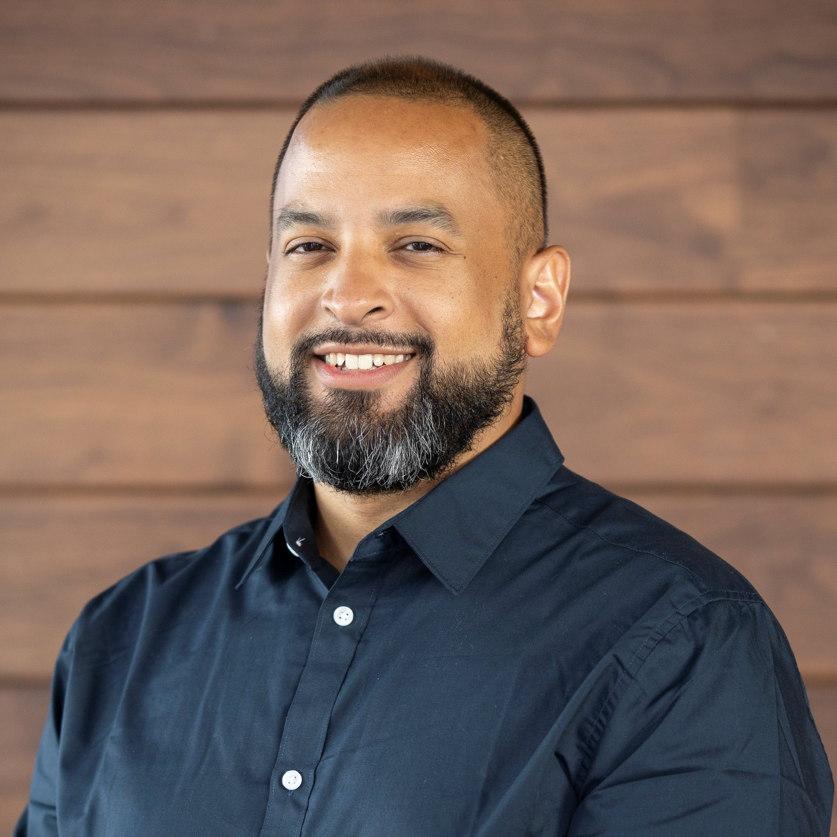
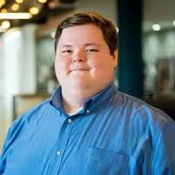
TEAM
Built by Operators Who Lived the Problem
We built the operating model inside regulated environments before turning it into a platform.
Raum Sandoval
Henry Steele
CEO & CO-FOUNDER
CTO & CO-FOUNDER
Former CISO & MSP operations leader 20 years across MSP, security, and regulated industries · Built secure automation and operational workflows inside real organizations
Former Deputy CISO and security operations leader Governance, incident response, compliance, automation, and secure architecture · Architecting Flowchestra's Secure AI Operations platform
LEADERSHIP TEAM
STRATEGIC ADVISORS
Kaya Kowalczyk
Bill Taylor
Richard Munassi
Yagub Rahimov
Director of Business Operations
Director of Client Success
Strategic Advisor
Advisor & Strategic Partner
20+ years managed services & legal tech · Operations, process & scalable execution
10 years in MSP enablement · TruMethods / Kaseya · Customer success & operations
Tampa Bay Wave · Techstars · NASA
CEO, Polygraf AI · Repeat founder · AI governance, privacy & trust
The Flowchestra operating model was validated and prototyped in real-world MSP/MSSP and regulated environments before the platform was built.
Notes:
Founder-market fit: we ran security and operations inside regulated environments, built the operating model there, then productized it.

Slide 10

AI works best when business works first.
Flowchestra operationalizes AI.
Flowchestra turns fragmented AI adoption into governed, accountable, repeatable business execution.
CAPITAL
CUSTOMERS
AI SERVICE PROVIDERS
Raising $1M
Regulated and operationally complex organizations
MSPs, AI consultancies, systems integrators, governance firms
Accelerating enterprise readiness: security, compliance, product maturity, customer success, and commercialization
Ready to operationalize real AI workflows with measurable outcomes and reduced operational risk.
Ready to operationalize AI for clients at scale, expand service revenue, and create new client opportunities.
The risk isn't AI.
INVESTOR RELATIONS
Learn more or connect
flowchestra.com Raum Sandoval
The risk is unmanaged AI.
Notes:
Close on the principle, then the three asks: capital, customers, AI service providers. End on the punchline.

